Slide 1

Do we really know everything about relay hot switching?
Arlo Blanco

Slide 2






Slide 3

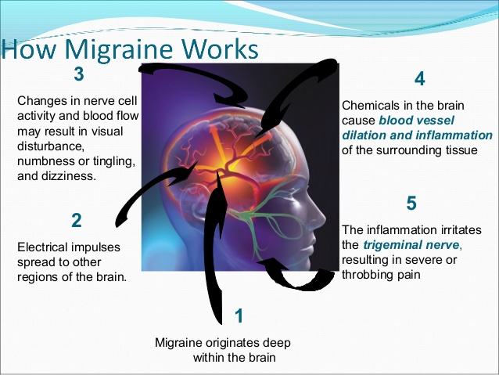

Doctor’s Appointment
Migraine
or
Brain Tumor

Slide 4
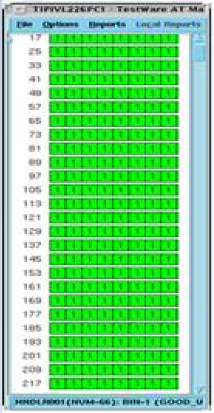
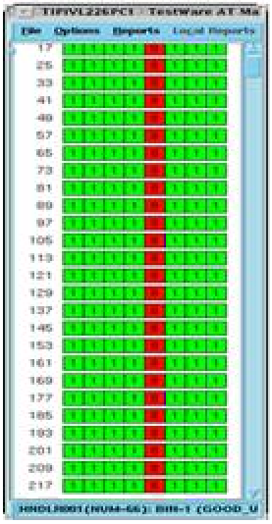
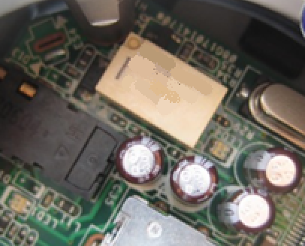
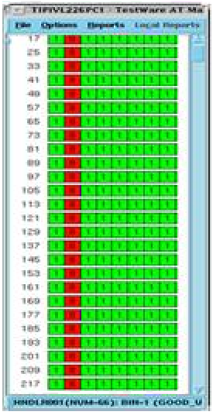
Device Won’t Pass (DWP)
Site to site issues
After isolation,
You found out it was due to a failing relay
Setup is now passing
Relay was replaced
** Based on 2014 data, an annual total of 720 production hours lost due to DWP issue
1 Month loss
The next day, setup is down due to DWP again, but on a different Site
After isolation,
You found out again that it was due to that same kind of relay
Never ending cycle
Relay was replaced, and setup is fixed
Notes:
We can do this again an again..
But we are engineers.. Like the doctor in the previous example
Us, engineers were born to find for root causes and solve the problem
If not, our PDO will be affected.

Slide 5
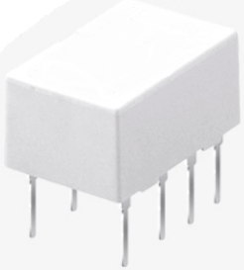
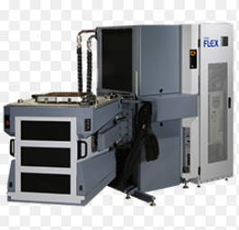

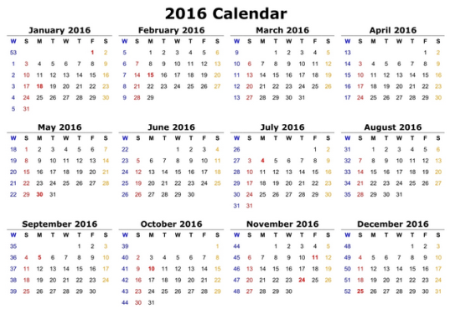
4 Tester Setups
Whole year
Cost per year
1460
X $5
$7300
$5 each
Php 335,800
per year
1 Relay replacement per day
What if 5 or more setups?
Just one device
1460 Relay replacements per year
4 Relay replacements per day

Slide 6
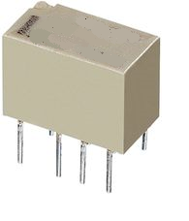
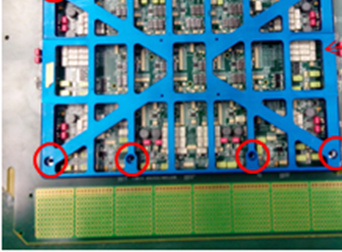
Frequent
Relay
Failure
Total of 32 Affected Relays per loadboard
.. And a lot of different active and passive components
Notes:
Board complexity – 32 relays per loadboard
Active and passive components

Slide 7
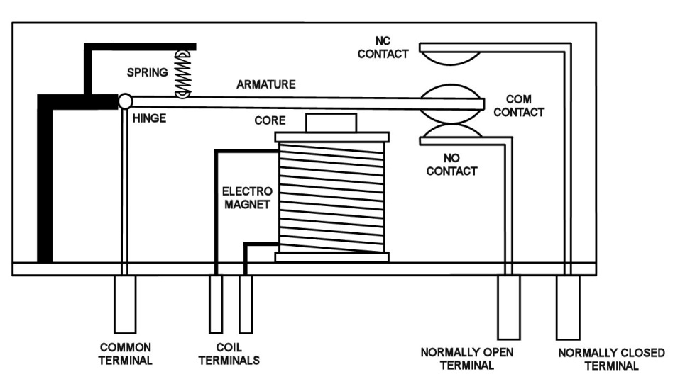
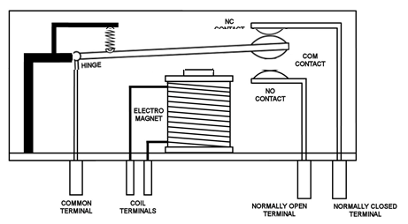

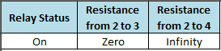
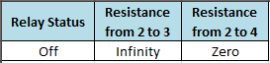

Why do we need relays?
A Relay is an electrically operated switch
.. We need to turn things ON & OFF
Mechanical Relay
On
Off
2
3
4
Notes:
Explain relay operation
Ideal resistance of a relay = 0ohm
Use numbers
And create separate tables

Slide 8
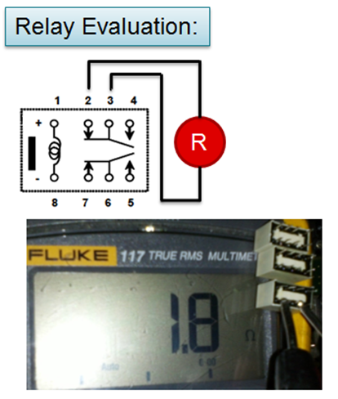
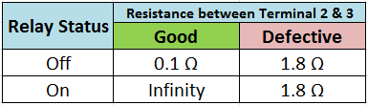
Not Switching
For FA
Notes:
Possible causes of damage
Typical signature of electrical stress
Voltage used
Toggles
Not end of life
Abused
End of life
Hot switching
Explain effect to testing
Ideal readings table

Slide 9
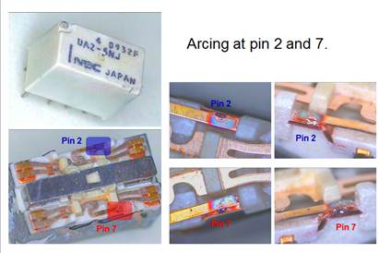
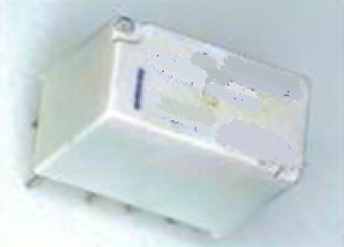
Relay stuck-up where contacts were welded to each other
Defective Relay
Good Relay
Notes:
Create animation on working and stuck relay
Highlight welding and stuck terminal – show weld

Slide 10
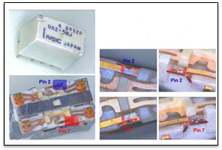
Fishbone Diagram
Man
Machine
Wrong Relay
Installed
Tester issue
Defective Relay
Loadboard Design
Overcurrent
End of life
Hot Switching
Material
Method

Slide 11
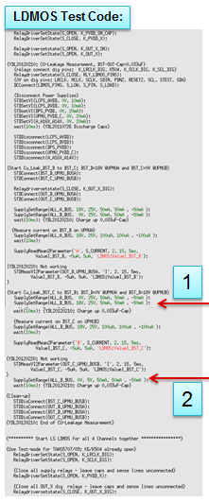
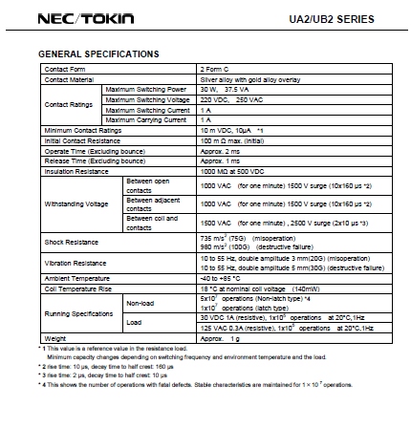


Probable Causes
Overcurrent
- Current forced on the test program is way above the rated specifications of the relay
Test Program
Relay Datasheet
End of life
- Relay has reached its usable life due to performing its maximum number of toggles
Welding is an indicator
of Hot Switching
Test Program
Relay Datasheet
Hot Switching
- Turning on a switch where a potential difference is present between the terminals to be connected
Failure is actually too early
Expected = ~10M
Actual = ~600k
Notes:
Create fishbone prior this slide

Slide 12

What is Hot Switching?
+V
0V

Slide 13
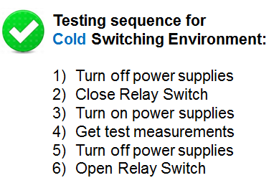

+V
0V
Cold Switching
+V
+V
0V
0V

Slide 14
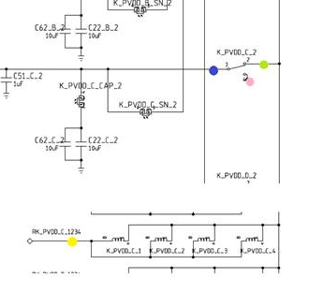
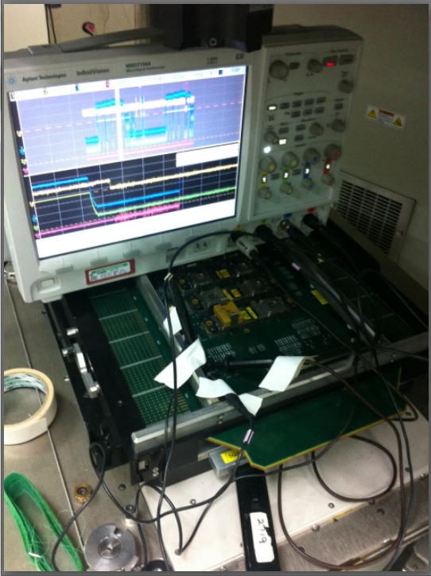
How to catch hot switching?
Loadboard
Schematic
Test Program
Oscilloscope

Slide 15
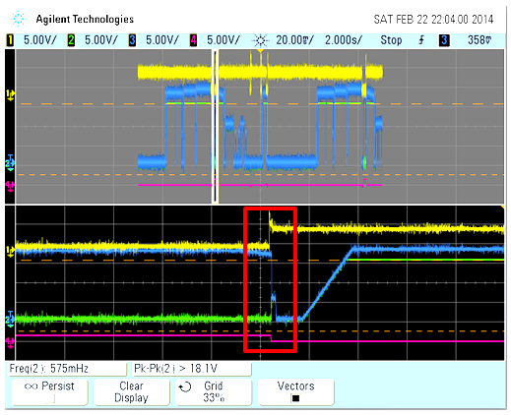
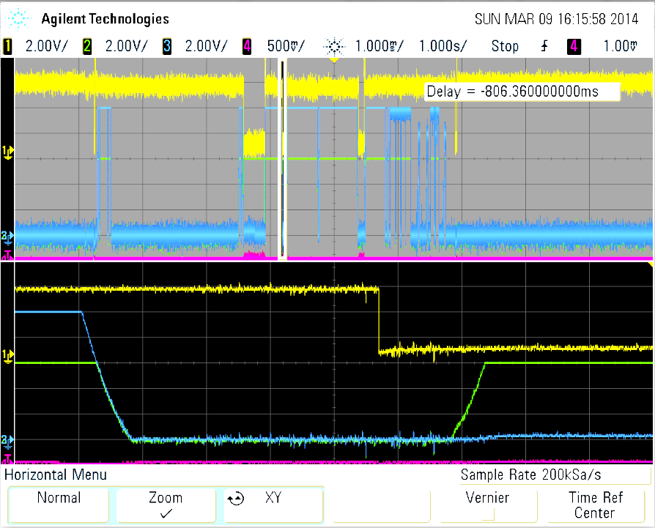

Evidence of Hot Switching
Sample of Good scope reading
+18V
0V
Notes:
Explain scope readings
Mention sources - can be supplied or from charged cap

Slide 16
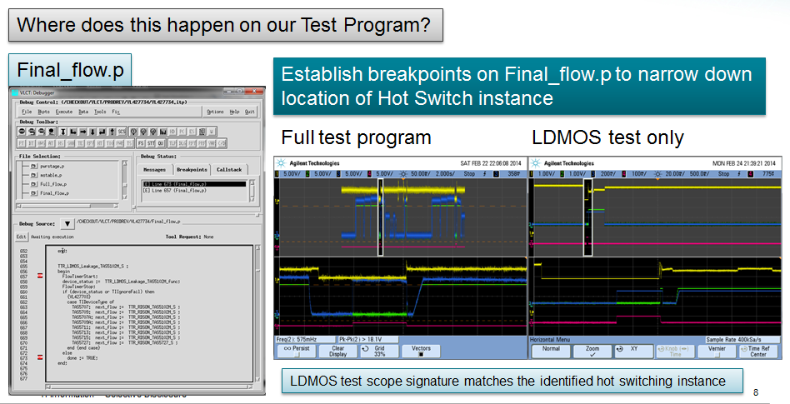
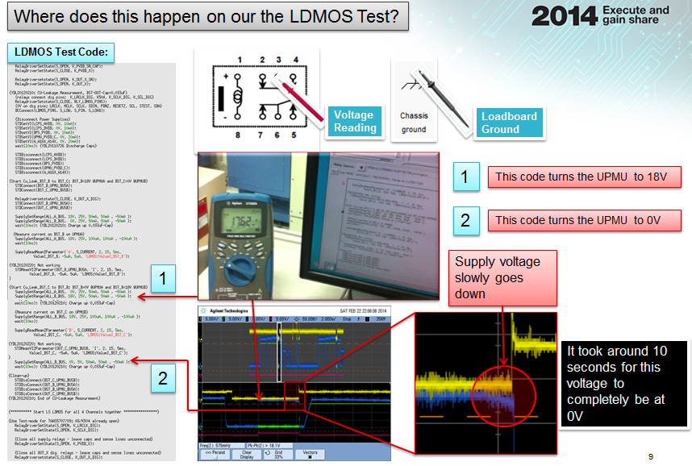

Test Program Audit
.. Searched for Potential Hot Switching occurrences
No power supplies left ON before switching
Power up & power down statements are in the correct sequence
No Issues found
Cold switching method was followed

Slide 17

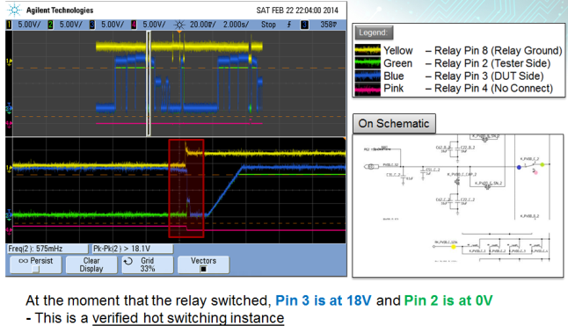
WTF??
(Why The Fail?)
If it is following the correct procedure..
Why are we still encountering hot switching???

Slide 18
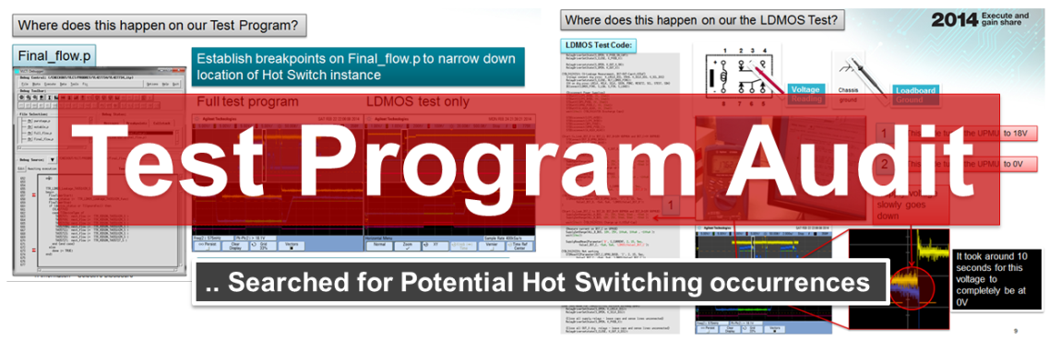
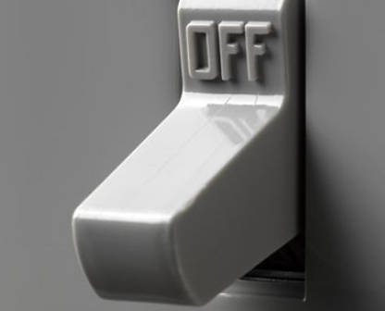
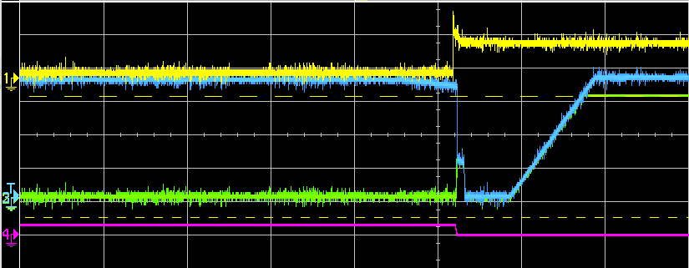
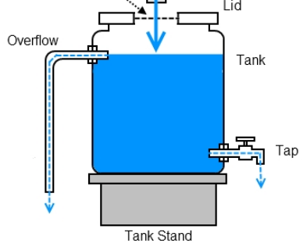

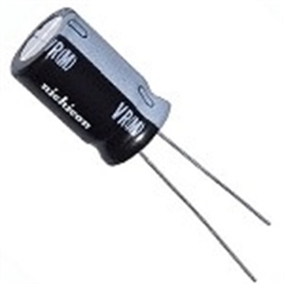

Brainstorming..
Power Supplies
Why???
Water Tank
Capacitor

Slide 19
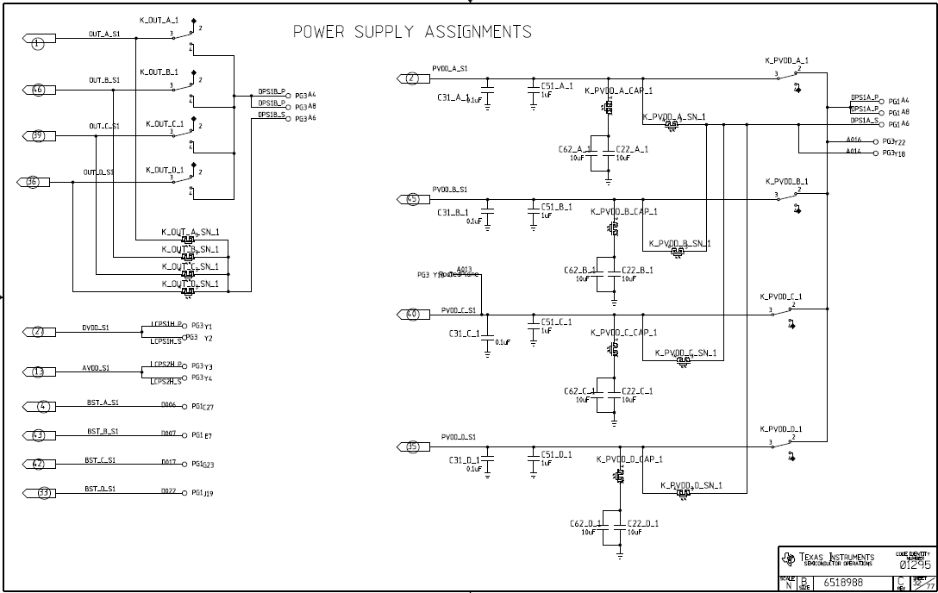
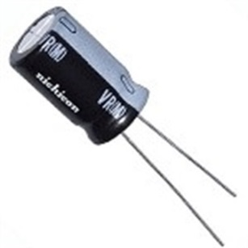
Looking further...
Something strange..
Loadboard
Schematic
Loadboard
Schematic
Capacitors
Affected Relay
Capacitors
Test
No Electrical Connection

Slide 20
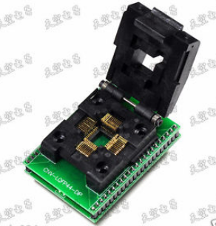
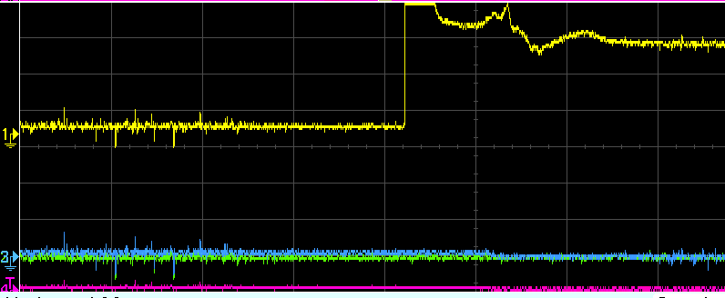
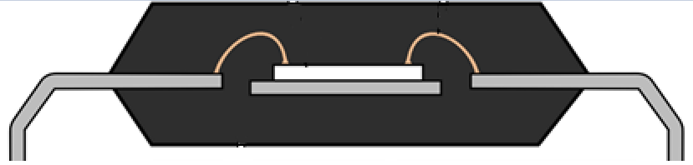
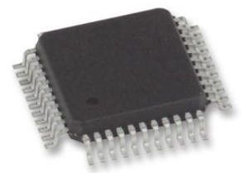


More Evaluations..
Open socket test
No Hot Switching issues
Capacitors
Current Bridge
- Testing without any unit placed
Device Testing
Confirmed Hot Switching issues
Capacitors

Slide 21





Concluded that..
A lot of times..
Hot Switching
0V
+18V
Notes:
Looking back at our scope readings – slow discharge – capacitor

Slide 22
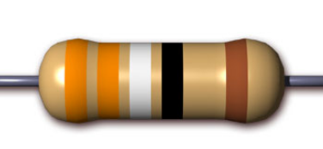
Solution Options..
1) Remove the Capacitor
- needed for testing
2) Add a resistor to discharge the current
- testing failed with the presence of a resistor
3) Use the tester to discharge the current
- This might work!

Slide 23
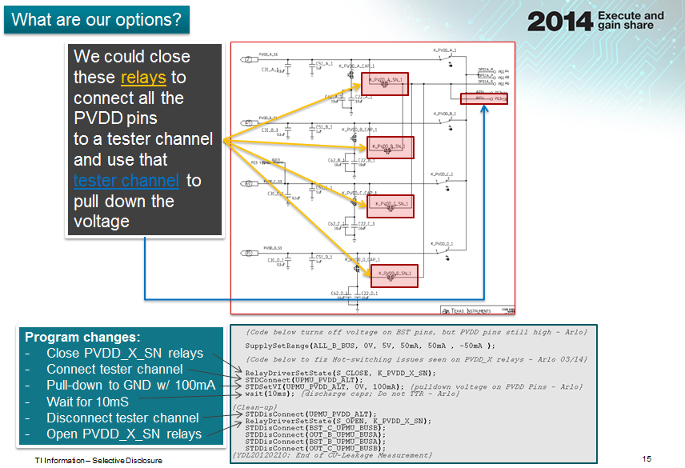
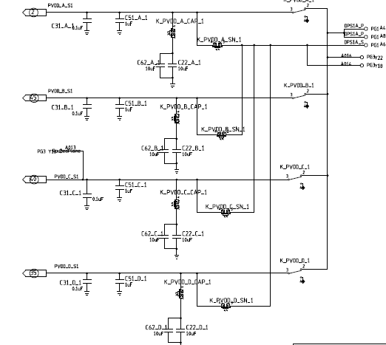

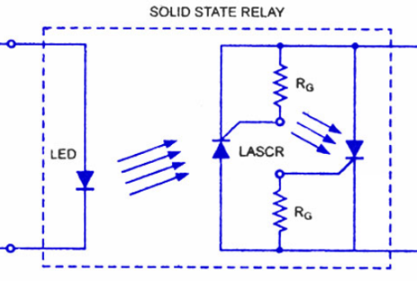

Fixing the problem
How do we discharge the capacitor using the tester?
tester channel
Solid State Relay
Invulnerable to
hot switching
Notes:
Expound on fix
Options fixing hot switching – choose best option – resistor – remove cap – use different path
Before and after scope shots

Slide 24

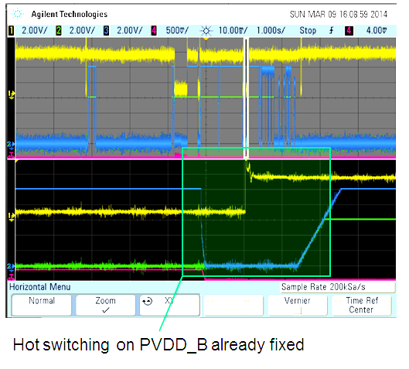

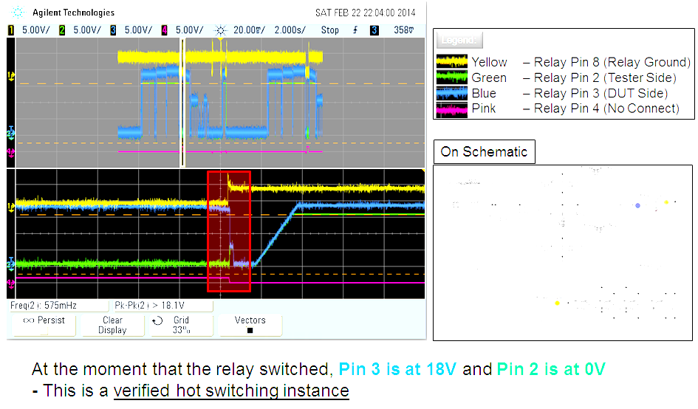
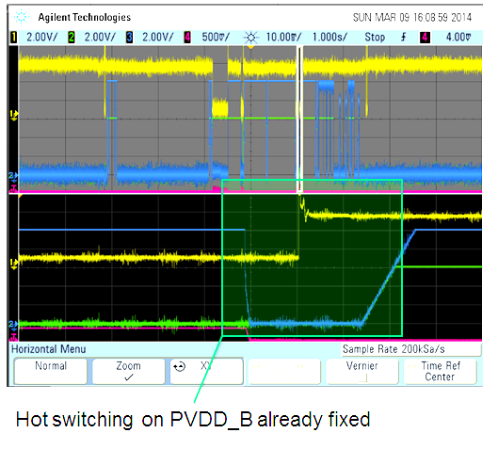
Before
After

Slide 25
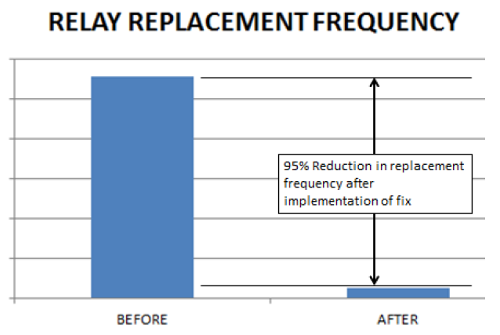
Effect..
95%
reduction in relay replacement
per QTR
Notes:
Show relay savings 1st

Slide 26

What was solved?
Relay replacement
Yield loss
Tech Support for
repairs
Cost Savings
Frequent repairs = multiple downtime
= Capacity loss

Slide 27

And the best thing about it…
Project is ZERO COST
.. Best things in life are free

Slide 28
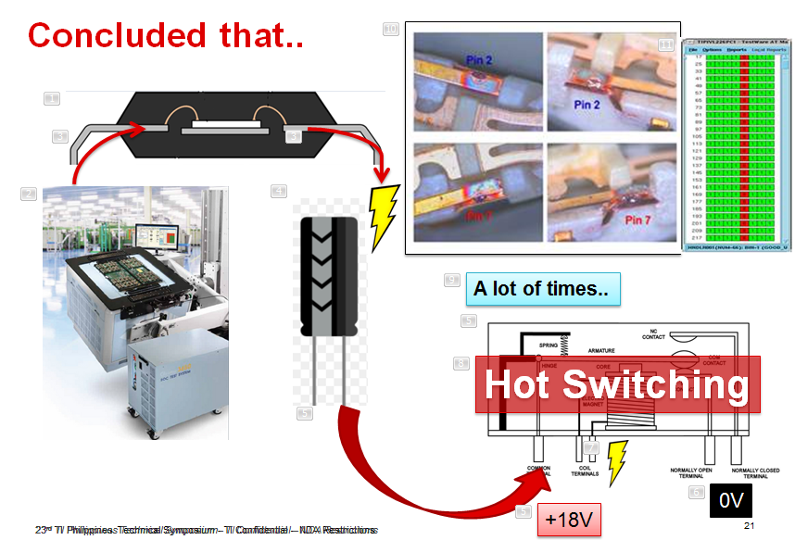

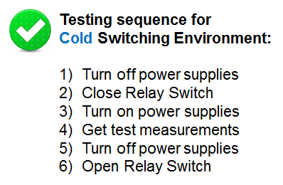
Technical Paper Innovation
Test Program
Information Breakthrough

Slide 29







Fan-Out / Recommendation
TIPI
Devices with Frequent Relay Replacement Issues
Clark
A B C D E F G H I J K L M N O P Q R
TITL TIM TIEM TMX
Chengdu FAB Subcons…
Training done
QFN Test
Probe
Notes:
Animate – focus
Conducted a training at Clark

Slide 30
Acknowledgment
I would like to thank the following people for support on this project:
For Technical Advice:
Butch Balanon (Apps)
Mike Rigos (PE)
Patrick Callo (PELD)
Noriel Pachejo (PE)
Noel Gregorio (PELD)
For Relay Evaluation support:
Adnel Carbonell (C-shop)
Edison Audar (C-shop)
Engineering Tester Allocation Support:
Philip Cabatbat (VLCT MFG)
Shirlyn Mates (BU Planner)
Millet Paguyo (Cap Planner)

Slide 31
Always remember…
..Then turn me ON
Turn everything else OFF…

Slide 32
Thank you!

Slide 34

Relay Datasheet

